Slide 1
Activities Unlimited History Club A Review of Four Historically Significant United States States Presidential Elections
July 25, 2023

Slide 2
United States Presidential Elections
I encourage you to ask questions at any time
Raise your hand, don’t shout out
I may not call on you immediately, but I will when the time is appropriate
I will try my best to answer your questions
However, since I am not a scholar, I may not know the answer to a particular question

Slide 3
United States Presidential Elections
Presidential Elections
Some memorable, some infamous
Historians have reviewed archival documents for judgments on these elections
Three in our lifetime
1948 Truman vs Dewey
1960 Kennedy vs Nixon
2000 Bush vs Gore
One which historians consider the most corrupt
1876 Hayes vs Tilden

Slide 4
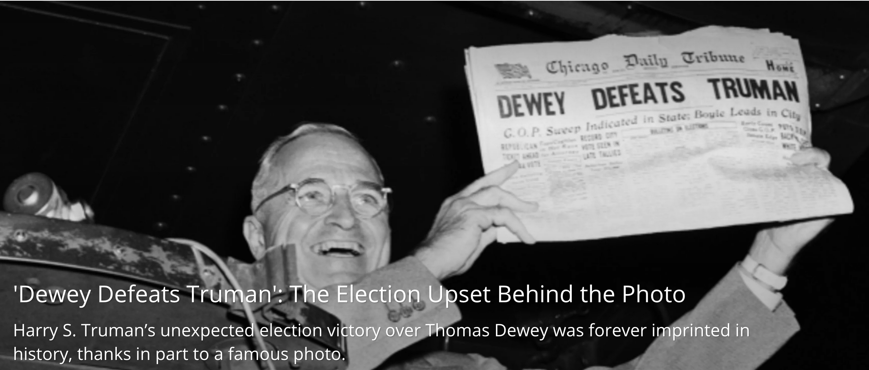
United States Presidential Elections
1948 Truman versus Dewey*

Slide 5
United States Presidential Elections
Truman vs Dewey*
Truman’s approval rating was seen as a severe handicap against Dewey’s popularity*
In April 1948, Truman’s approval rating was 38% the low point of 1948
Dewey ran an uninspiring, risk-averse campaign
Heading into election day, November 2, 1948, Thomas Dewey was considered the next U.S. president by many newspapers, magazines, and political pundits.

Slide 6
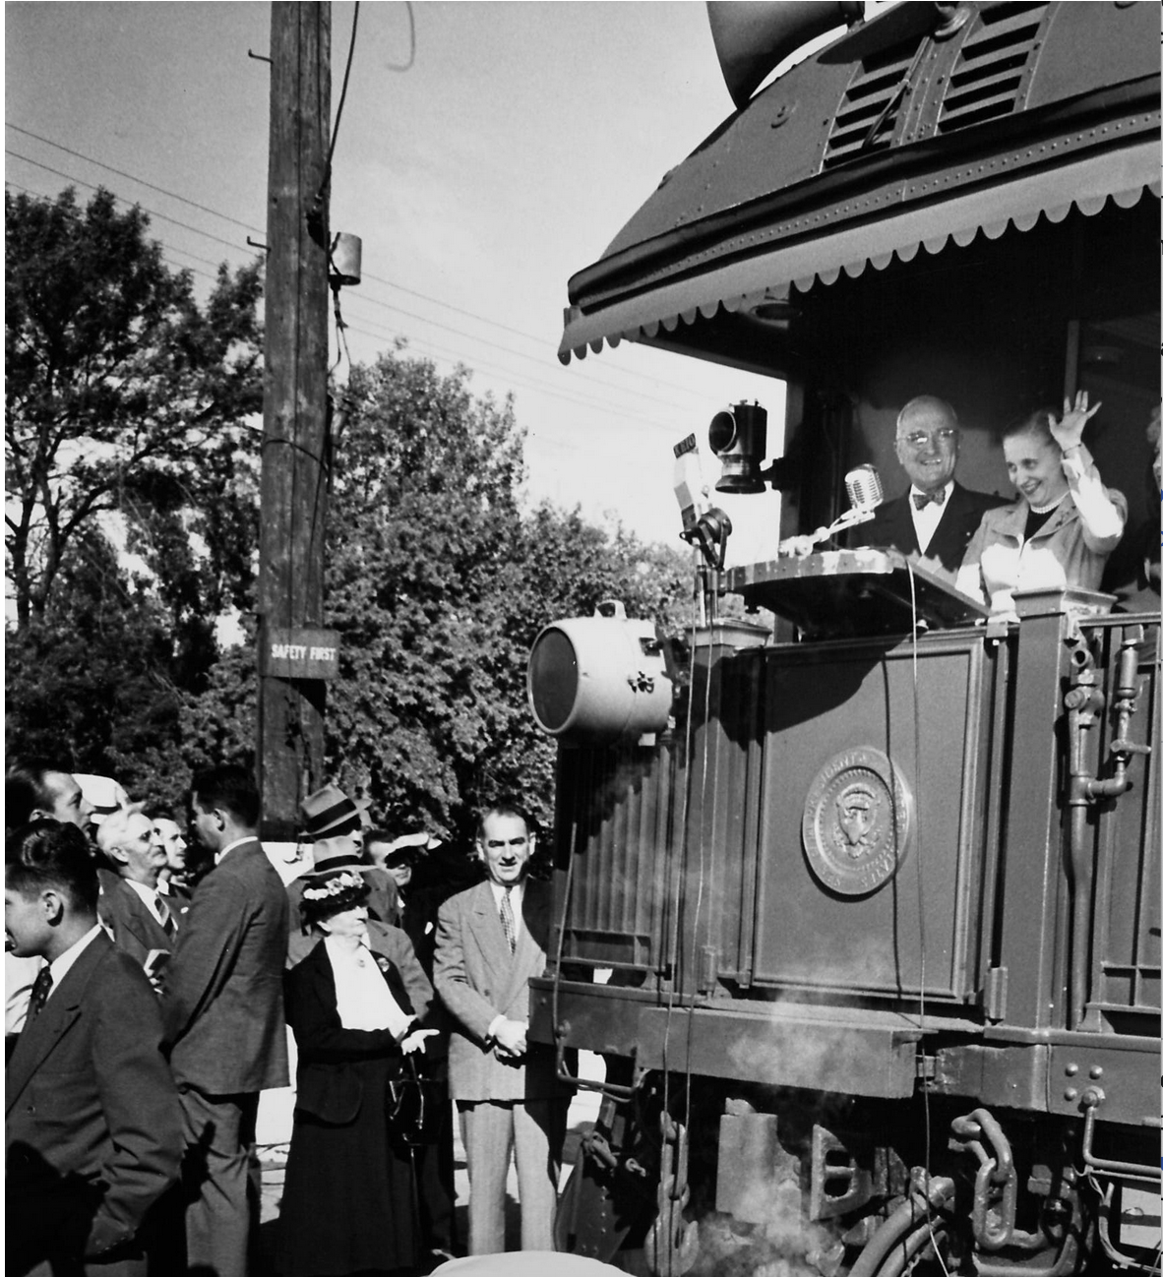
1948 Election – Truman vs Dewey

Slide 7
United States Presidential Elections Harry Truman’s whistle stop tour

Slide 8
United States Presidential Elections
Truman vs Dewey
Election results
Truman 303 Electoral votes, Dewey 189
Truman won over 2 million more popular votes than Dewey
Truman is ranked among the top ten presidents by both conservative and liberal scholars

Slide 9
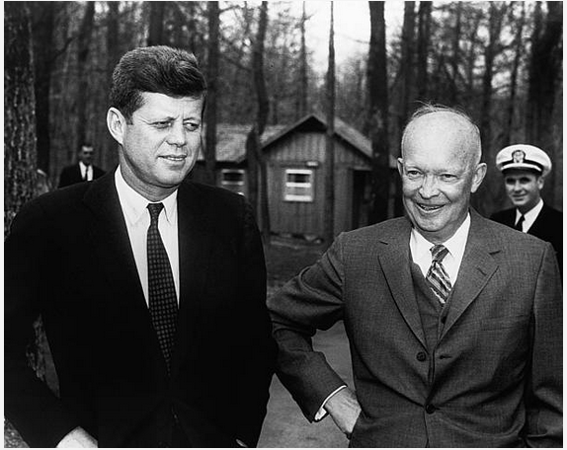
United States Presidential Elections
1960 Kennedy versus Nixon*

Slide 10
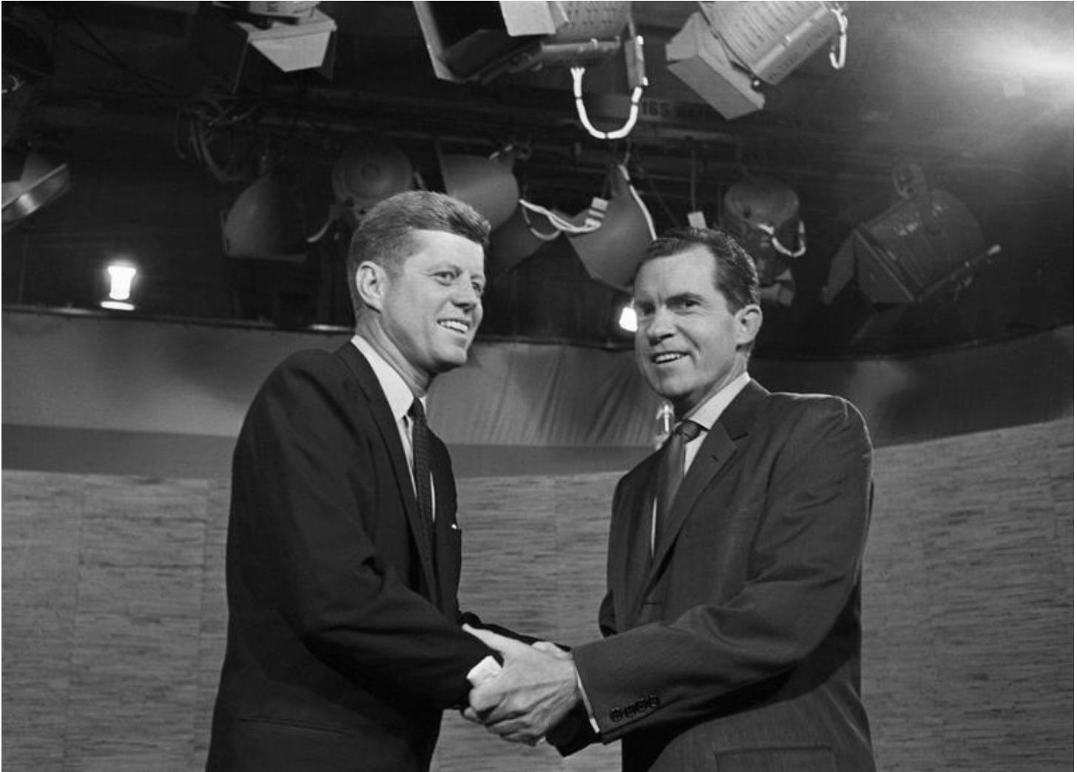
United States Presidential Elections
1960 Kennedy versus Nixon*

Slide 11
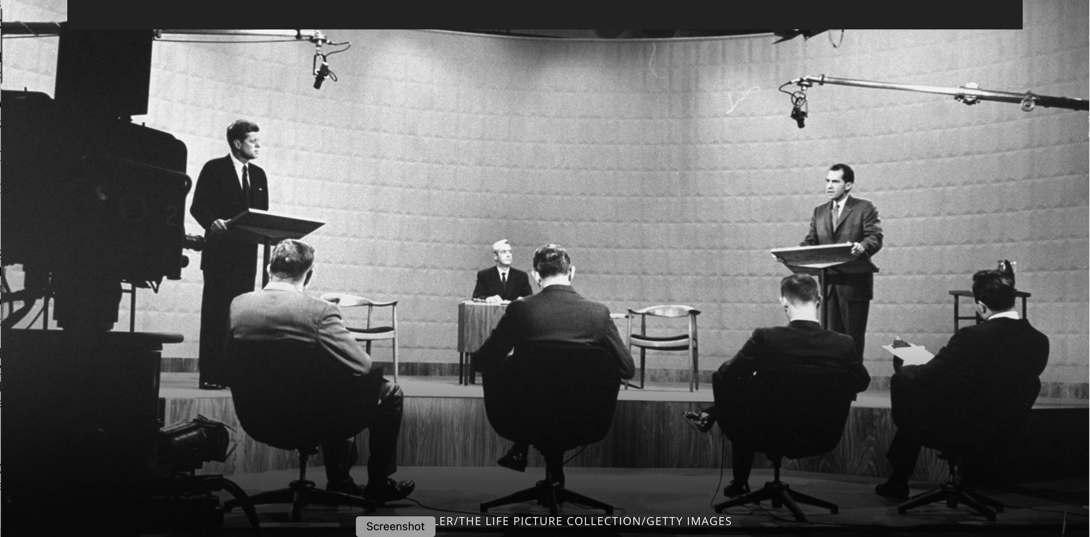
United States Presidential Elections
1960 Kennedy versus Nixon*

Slide 12
I960 Election – Kennedy vs Nixon
Candidate | Party | Electoral Votes | Popular Votes
John F. Kennedy | Democratic | 303 | 34,227,096
Richard M. Nixon | Republican | 219 | 34,107,646
Harry F. Byrd | Democratic | 15 | 116,248

Slide 13
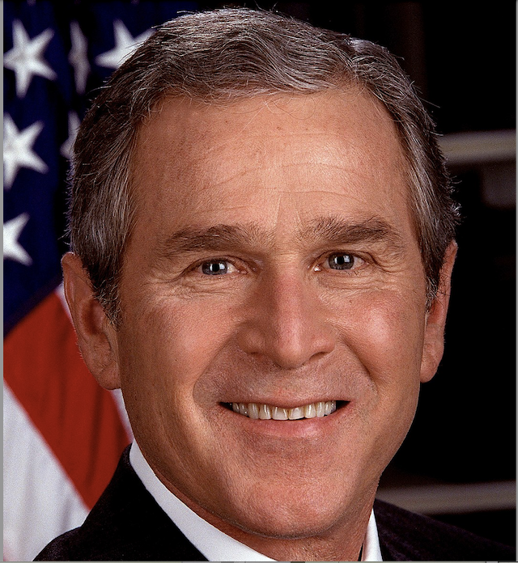
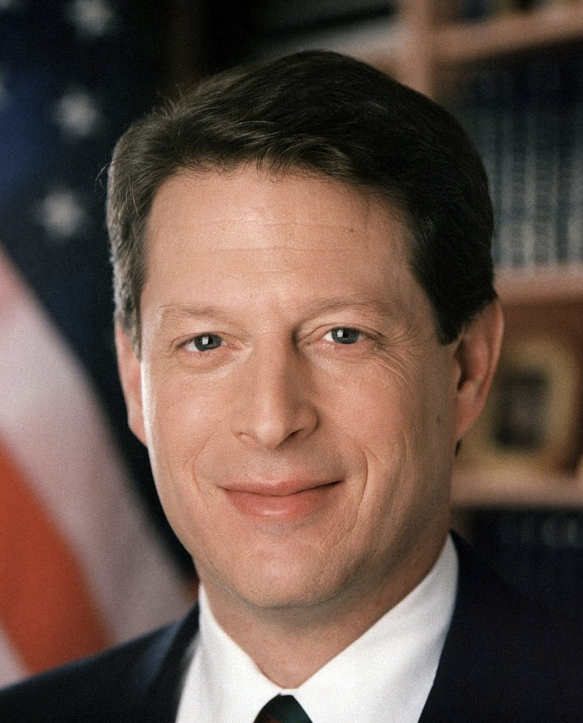
2000 Election – Bush vs Gore

Slide 14
2000 Election – Bush vs Gore
No clear winner on election night November 7, 2000 when the polling places closed
Three states had not declared a winner
Florida (25), Oregon (7), and New Mexico (5)
Gore eventually won Oregon and New Mexico
Whoever won Florida’s 25 electoral votes was the next president of the United States
The term chads became the hot item of the moment

Slide 15
2000 Election – Bush vs Gore

Slide 16
2000 Election – Bush vs Gore
Election controversies
Chads
Conflicts of interest
Florida’s election laws

Slide 17
2000 Election – Bush vs Gore
Chads
Hanging chad
Attached to the ballot at only on corner
Swinging chad
Attached to the ballot at two corners
Pregnant chad
Attached to the ballot at all four corners but bears an indentation indicating the voter may have intend to mark the ballot

Slide 18
2000 Election – Bush vs Gore
Chads
Overvotes
Ballots that recorded multiple votes for the same office
Undervotes
Ballots that recorded no vote for a given office

Slide 19
2000 Election – Bush vs Gore
Conflicts of interest
Jeb Bush was governor
Bob Butterworth, Florida’s Attorney General, headed Bush’s Florida Campaign
Katherine Harris, Secretary of State, was co-chair of Bush’s Florida campaign

Slide 20
2000 Election – Bush vs Gore
Florida’s election laws
Machine recount of all votes cast when the margin of victory was less then 0.5 percent.
The gap in this race, appeared to be less than 0.01 percent
On election night, November 7, 2000, no clear winner in Florida
Media initially projected Gore the winner
Later declared Bush had opened an insurmountable lead
Based on this information Gore called Bush to concede the election*

Slide 21
2000 Election – Bush vs Gore
A machine count of the ballots was completed on November 10th
Conflict arose between Florida’s Secretary of State and Florida Supreme Court*
On December 8, in a 4–3 decision
Florida Supreme Court ordered immediate manual recounts of undervotes for the office of president
In all counties where such recounts had not already taken place.*
Based on the U.S. Supreme Court’s ruling
George W. Bush was elected the 43rd president of the United States

Slide 22
2000 Election – Bush vs Gore
Final vote totals nation wide
Candidate | Party | Electoral Votes | Popular Votes
George W. Bush | Republican | 271 | 50,456,002
Al Gore | Democratic | 266 | 50,999,897

Slide 23
1876 Election – Hayes vs Tilden
Why discuss this election
Historians have deemed this election the most corrupt in the history of the United State
Florida was the swing state for the election*
Reconstruction was a big factor in the outcome of the election
From 1867 when Congress passed the Reconstruction Act to 1877 when nearly 4 million formerly enslaved people were integrated into society*

Slide 24
1876 Election – Hayes vs Tilden
The Republican Party needed this election to maintain national power
Republicans controlled the White House from Abraham Lincoln’s first term in 1861 to Ulysses S. Grant’s second term ending in 1877*
If Hayes wins the election, the Republican Party will continue in power until 1885 with James Garfield and Chester A. Arthur*
Republicans also controlled both Houses of Congress until 1875

Slide 25
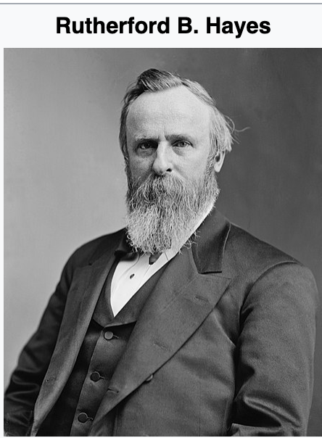
1876 Election – Hayes vs Tilden
b. October 4, 1822 d. January 17, 1893
President March 4, 1877 to March 4, 1881 55 years old when elected

Slide 26
1876 Election - Hayes vs Tilden
RUTHERFORD B. HAYES
His American heritage can be traced back to the 1680’s New England
In the early 1800’s Hayes’ family was struggling to make ends meet due to New England’s poor economy
1817 his family moved to Delaware, Ohio*
He had ambitions to become a lawyer*
Decided to attend Harvard Law School
Graduated in 1845 with a bachelor of laws degree

Slide 27
1876 Election - Hayes vs Tilden
RUTHERFORD B. HAYES
After graduation he settled in Cincinnati and opened a law practice*
His main source of income was defending runaway slaves who had fled across the Ohio River from Kentucky*
While in Cincinnati he met his future wife Lucy Ware Webb*

Slide 28
1876 Election - Hayes vs Tilden
RUTHERFORD B. HAYES
He served for the Union in the Civil War
Was wounded three times during his service
Retired from the Union Army at the end of the war with the rank of brevet Major General*
His bravery and leadership helped his political career*

Slide 29
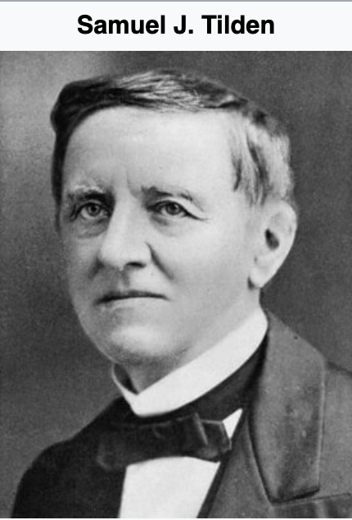
1876 Election – Hayes vs Tilden
b. February 9, 1814 d. August 4, 1886 62 years old at election day

Slide 30
1876 Election - Hayes vs Tilden
SAMUEL J. TILDEN
His family descended from early English settlers who came to North America in 1634
Tilden was born in New Lebanon, New York*
Elam and Polly Jones Tilden had eight children*
Very sickly as a child
Was unable to attend school regularly*

Slide 31
1876 Election - Hayes vs Tilden
SAMUEL J. TILDEN
At the age of 18, he moved to New York City*
Tilden became interested in politics*
At another attempt to complete his education he entered Yale University in June 1834
He left after one term*
He believed a law degree would help achieve his goals
In 1838 Tilden entered the School of Law of the University of the City of New York*

Slide 32
1876 Election - Hayes vs Tilden
SAMUEL J. TILDEN
Tilden prospered as a lawyer
He became a key attorney representing New York City
Fought corruption within the civil service system in NYC
Advised railroad companies*
He played a prominent role in the reorganization of the New York Democratic Party
Serving as the Party Chairman of the State of New York*
Tilden was elected governor of New York in 1874 as a champion of reform

Slide 33
1876 Election - Hayes vs Tilden
THE CAMPAIGN
Early 1870s economic depression, political scandals, and the Panic of 1873
Affected the popularity of the Republican Party*
Even though Black voters overwhelmingly supported the Republican Party
Democrats saw a path to electoral victory*
White Southerners supported the Democratic Party*

Slide 34
1876 Election - Hayes vs Tilden
THE CAMPAIGN
Ohio Governor Hayes ran on a reform platform*
He was hampered by the Grant Administration’s scandals and poor economic management
Hayes was well liked in the Republican Party*
The Republican National Convention was held in Cincinnati, Ohio
Very favorable for Hayes
Hayes won the nomination on the fifth ballot

Slide 35
1876 Election - Hayes vs Tilden
THE CAMPAIGN
New York Governor Tilden was known for challenging political corruption*
He was an obvious choice and the front runner for the Democratic Party’s presidential nominee*
Partial list of the Democratic platform
Repeal the Specie Payment Resumption Act*
Condemned the Grant Administration’s corruption
Reaffirmed the Reconstruction Amendments*
Civil service reform*

Slide 36
1876 Election - Hayes vs Tilden
THE CAMPAIGN
At this time, Democrats controlled the House of Representatives
Passed a statehood bill for Colorado*
Now Tilden aggressively focused on winning the crucial New York state vote and its 35 electoral votes
It was considered improper for a candidate to actively campaign for the presidency
Neither candidate stumped as part of their campaign
Was the duty of their surrogates

Slide 37
1876 Election - Hayes vs Tilden
THE CAMPAIGN
A cutthroat campaign by both camps*
Democrats attacked the corruption in Grant’s administration
Republicans countered with attacks on the Democrats positions on the Civil War
If votes had been counted accurately and fairly in Southern states, Hayes might have won the 1876 election outright

Slide 38
1876 Election - Hayes vs Tilden
ELECTION DAY – NOVEMBER 7, 1876
Both parties participated in rampant fraud
Republican operatives
Stuffed ballot boxes
Allowed repeat votes
Threw out Democratic ballots
Democrat operatives
Violence against and intimidation of black voters in the Southern United States
An attempt to keep them from the polling places

Slide 39
1876 Election - Hayes vs Tilden
ELECTION DAY – NOVEMBER 7, 1876
On election night Hayes prepared his concession speech
He was losing badly*
Tilden was so confident he had won he went to bed early
As the final votes came in
It became evident in four states the results were not clear
Both parties claimed victory without a final count*

Slide 40
1876 Election - Hayes vs Tilden
POST ELECTION
The Republican National Party chair wired Republican officials in Florida, Louisiana, South Carolina, and Oregon to hold their states for Hayes
In response, the Democratic National Party organized committees of prominent Democrats to travel South and oversee the vote counting*
On December 6, 1876, the electors of the four contested states
Met in their respective state capitals to cast their ballots*

Slide 41
1876 Election - Hayes vs Tilden
1877 ELECTORAL COMMISSION ACT
The election was at a stalemate
Since the Democrats controlled the House and the Republicans the Senate
A variety of proposals where bitterly rejected by each side
On January 29, 1877, a solution to the impasse was agreed upon
The 1877 Electoral Commission Act*
15 members formed the commission*
After the commission members were selected
The independent member of the Supreme Court resigned*

Slide 42
1876 Election - Hayes vs Tilden
1877 ELECTORAL COMMISSION ACT
The Commission began hearing arguments on February 1,1877 in the U. S. Supreme Court chamber
The first action by the Commission
Florida’s electoral votes*
After Florida award all 20 electoral votes to Hayes
An informal, back-room deal*
The Commission’s ruling was reported to Congress on February 23, 1877

Slide 43
1876 Election - Hayes vs Tilden
1877 ELECTORAL COMMISSION ACT
Congress convened on March 1st to complete the tally of electoral votes
Work was completed at 4 AM March 2nd
Hayes was declared the winner
Hayes was sworn in privately on March 3rd
Inauguration Day was March 4,1877 which happened to be a Sunday
The public swearing in took place on Monday, March 5th *

Slide 44
1876 Election - Hayes vs Tilden
TILDEN POST ELECTION
Tilden continued to have a commanding position in the National Democratic Party
In both 1880 and 1884 presidential elections, Tilden declined to run
Both times due to health issues
Tilden retired after the 1884 Democratic Convention*
He continued to have bad health
Died a bachelor on August 4, 1886*

Slide 45
United States Presidential Elections
1877 ELECTORAL COMMISSION ACT
Historians believed there was an outside influencer hired to keep control over both political parties
To this day, Historians have not determined his name
He was ruthless, my way or suffer the consequences
It was believed he commissioned an Italian composer for his theme
During my research for this presentation, I found a YouTube clip of a man from the Old West with no name
I assumed this was the man
The clip shows what happens when someone got on his bad side

Slide 46
United States Presidential Elections

Slide 47
United States Presidential Elections
THANK YOU

